Slide 1
Final Project DS 5110: Introduction to Data Management and Processing Amazon Best Seller Analysis in Discovering Consumer Preferences and Production Performance
Team Members: Runying Chen & Bohan Cao
December 3, 2024

Slide 2
Agenda
Introduction
Literature Review
Methodology
Results
Discussion
Conclusion

Slide 3

Introduction
Background: Growth of e-commerce, Amazon's role in global retail.
Objective: Analyze Amazon’s bestseller lists to understand market trends, consumer preferences, and pricing strategies.
Data: Collected on October 16, 2024, from Amazon's bestseller lists across 36 categories.

Slide 4
Literature Review
Key Research:
E-commerce and consumer interest (Trzebiński & Marciniak, 2023).
Challenges of outdated data and static datasets.
Importance of dynamic data collection for current insights (Zhang, 2024).
Gap: Real-time data, interactive visualizations, and broader category analysis are underexplored.

Slide 5
Methodology – Data Collection
Tool Used: ScrapeHero API for real-time data.
Data Collected: 36 categories, product ASIN, title, ratings, price, reviews, etc.
Automation: Python functions for efficient data extraction and transformation.

Slide 6
Methodology – Data Preprocessing
Handling Missing Values: Addressed manually or using Python functions.
Normalization: Z-score and Min-Max for continuous variables.
New Metrics: Estimated revenue and price-to-quality ratio.

Slide 7
Analysis Techniques
Correlation Analysis: Identified relationships between key variables.
Descriptive Analytics: Visualized category-level and product-level insights.
Textual Analysis: Used NLTK to analyze product titles for popular keywords.
Visualization Tools: D3.js, Recharts, React for interactive visualizations.

Slide 8
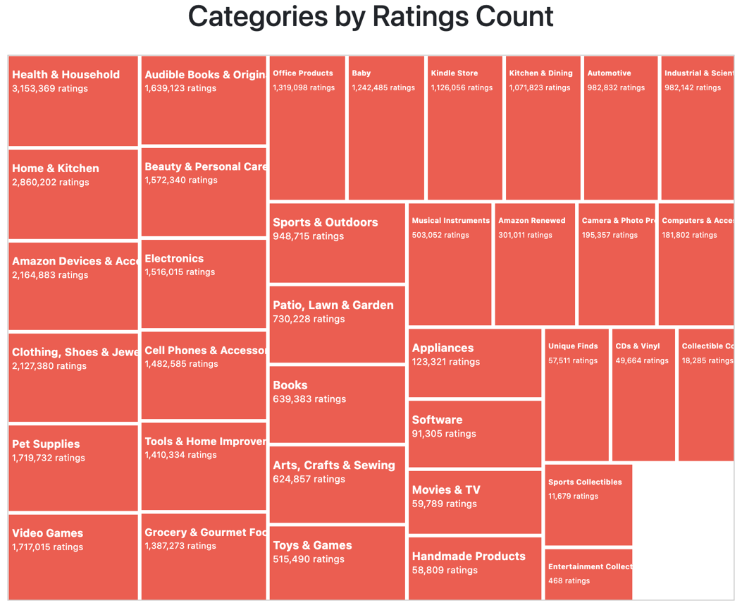
The treemap shows that categories such as Health & Household, Home & Kitchen, and Amazon Devices & Accessories have the highest customer engagement and satisfaction, as indicated by their large number of ratings.

Slide 9
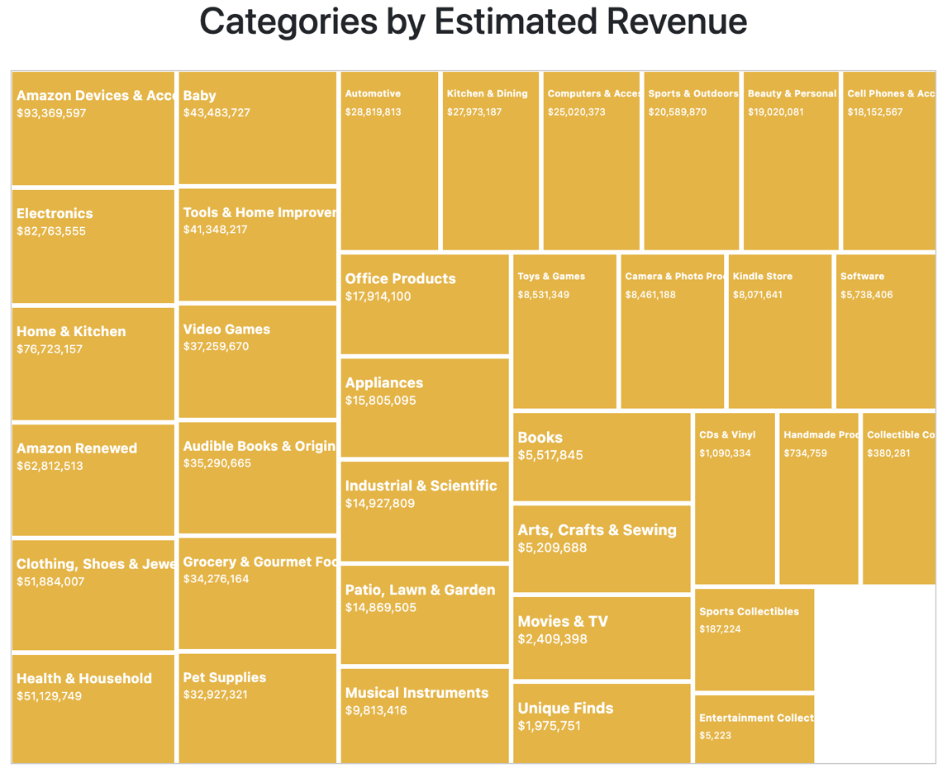
The treemap reveals that Amazon Devices & Accessories, Electronics, and Home & Kitchen lead in revenue, while Health & Household shows high customer engagement, suggesting that volume-driven sales contribute significantly to its success despite lower prices.

Slide 10
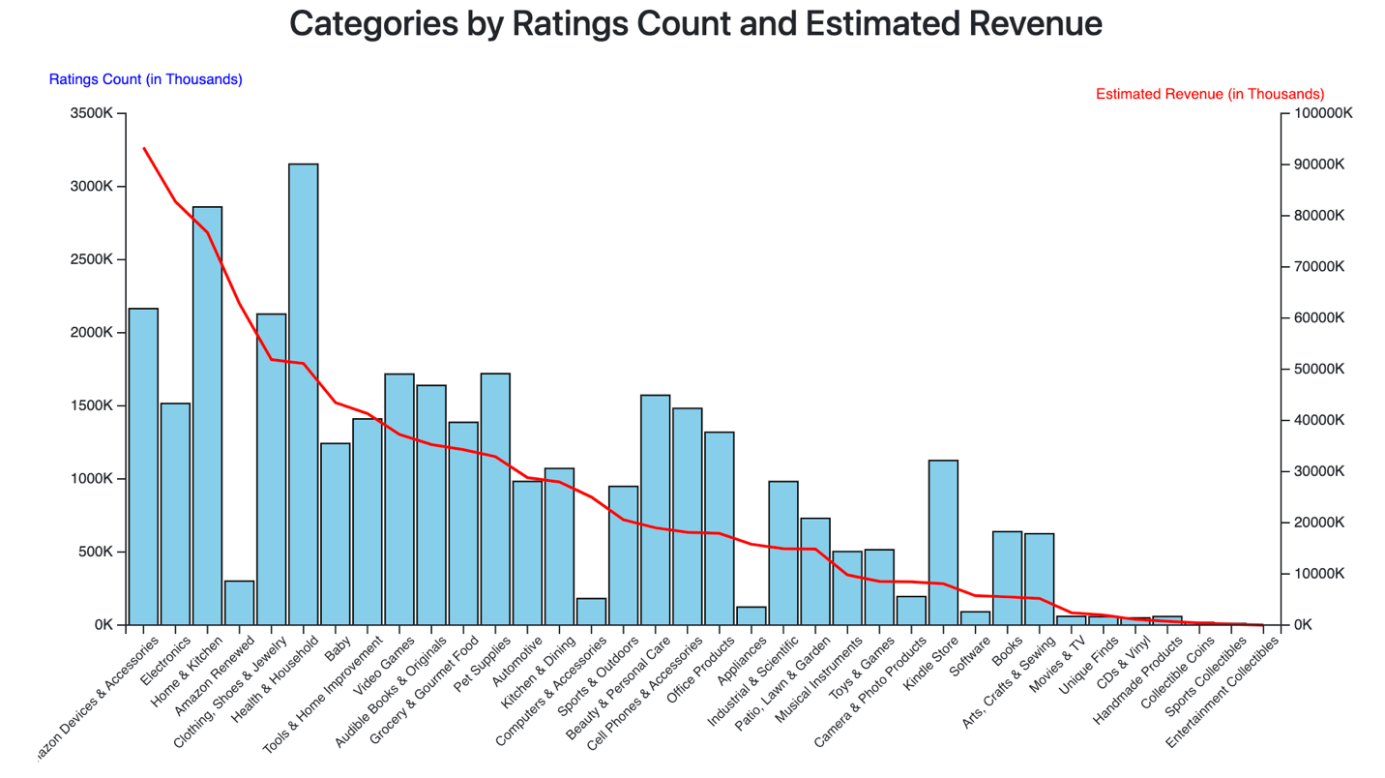
The dual-axis chart shows that categories like Amazon Devices & Accessories, Electronics, and Home & Kitchen lead in both customer ratings and revenue, indicating a strong link between engagement and sales performance.

Slide 11
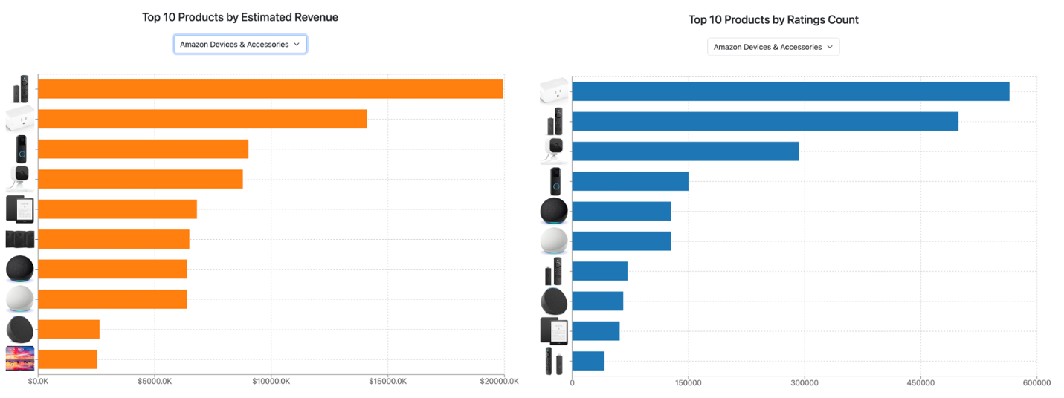
Top-performing products like the Amazon Echo Dot, TV remotes, and Kindle drive revenue in the Amazon Devices & Accessories category through innovation and meeting consumer demands for convenience and entertainment.

Slide 12
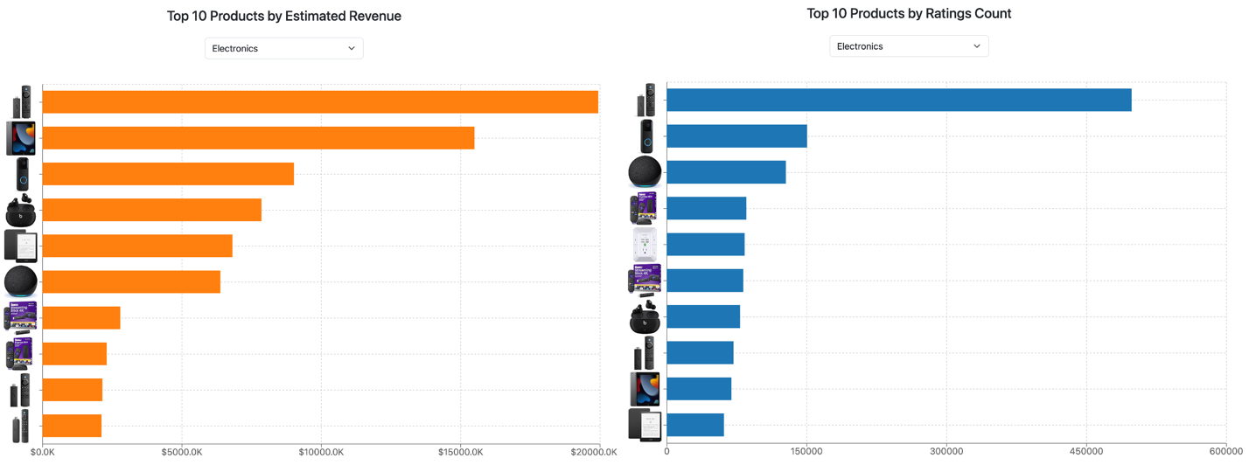
Products like the Amazon Echo Dot, Kindle, and Fire TV Stick dominate the Electronics category, with the Fire TV Stick driving significant sales and customer engagement due to its versatility and ease of use.

Slide 13
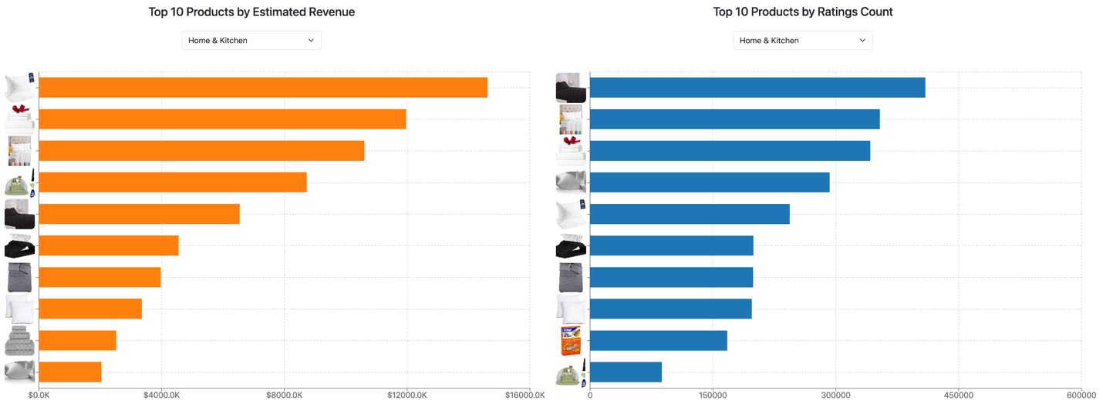
Bedding products like bed sheets, pillows, and pillowcases lead the Home & Kitchen category in both revenue and ratings, reflecting growing consumer investment in sleep quality and comfort.

Slide 14
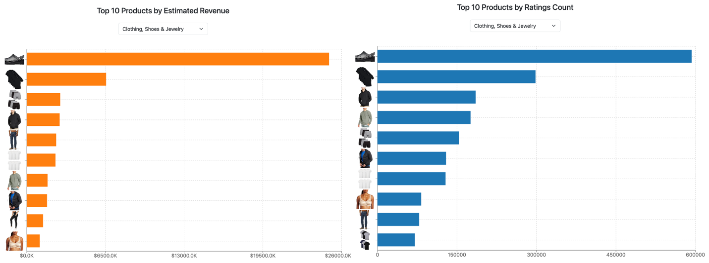
Clogs dominate the Clothing, Shoes & Jewelry category, while men's clothing, particularly jackets and hoodies, outperforms women's fashion, indicating a shift towards greater male engagement in online fashion shopping.

Slide 15
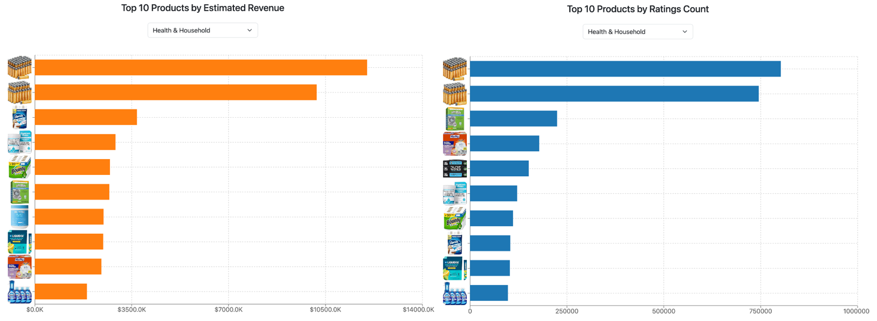
Amazon Basics High-Performance Batteries dominate the Health & Household category in both revenue and ratings, reflecting strong consumer trust in Amazon's in-house brand for essential products.

Slide 16
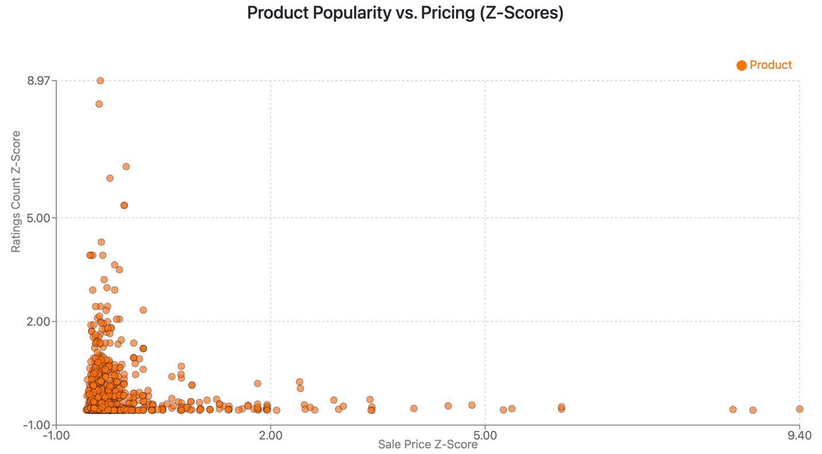
The scatter plot shows that lower-priced products receive more ratings, indicating greater popularity, while higher-priced items tend to attract fewer buyers.

Slide 17
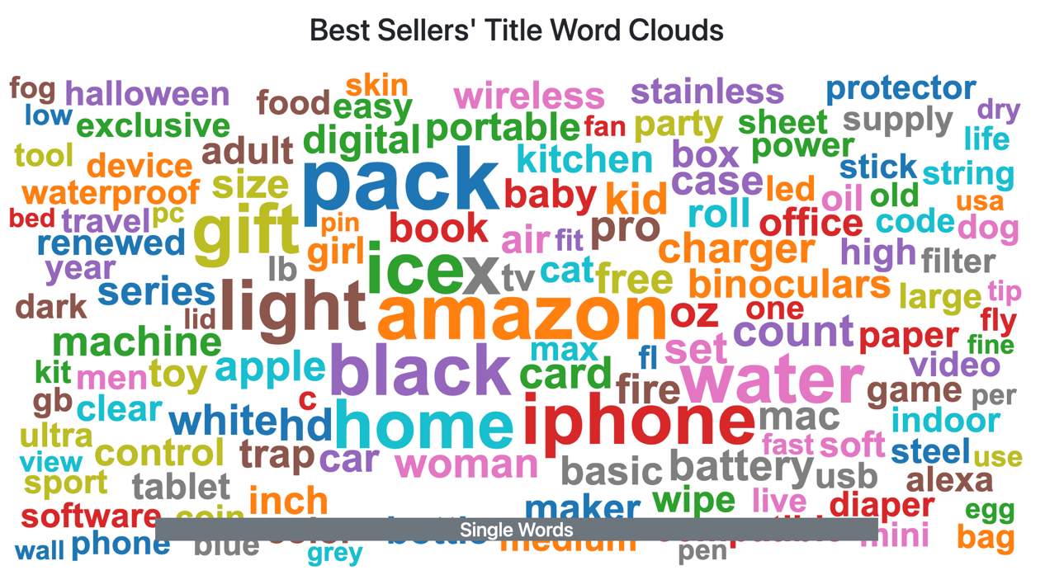
The word cloud reveals that popular terms like "pack," "gift," "iPhone," and "home" highlight consumer interest in multipacks, technology, home items, and gift-oriented products.

Slide 18
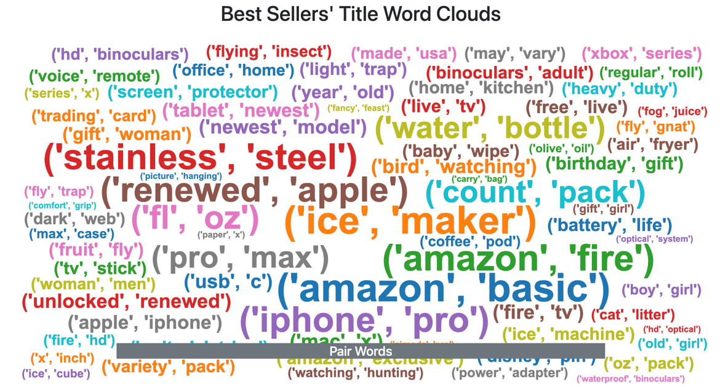
The word cloud of bigrams highlights trends in consumer preferences, such as demand for refurbished Apple products, bulk purchases, hydration items, and gifts for special occasions.

Slide 19

Discussion
Key Findings:
Amazon Devices & Accessories and Home & Kitchen lead in both ratings and revenue.
Health & Household shows high engagement but lower revenue.
Price sensitivity plays a major role in consumer behavior.
Consumer Behavior: Products with convenience and value perform best.

Slide 20

Conclusion
Summary: Key categories performing well in terms of engagement and revenue.
Insights: Price sensitivity, product features like "pack" and "gift," and the importance of customer engagement.
Future Research: Use diverse data sources, seasonal trends, and marketing campaigns.

Slide 21
References
Trzebiński, W., & Marciniak, B. (2023). E-commerce consumers' interest in product features. Journal of Internet Commerce, 22(2), 224–243.
Zhang, H. (2024). Personalized recommendation system for e-commerce. Applied Mathematics and Nonlinear Sciences, 9(1).

